Slide 1
Machine Readable Security Incident Notification

Slide 2


Slide 3
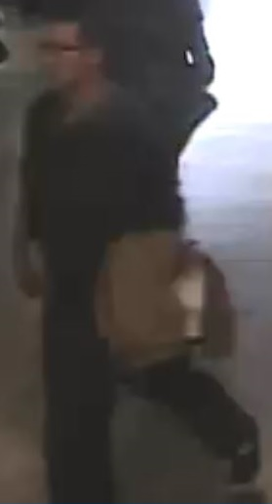
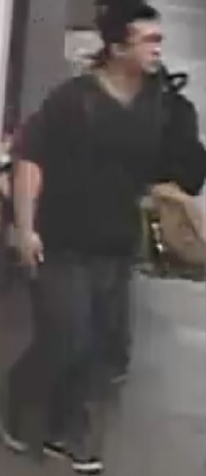
Assault with a Weapon (Ink Pen)
Incident Details:
On Monday November 03, 2014, at approximately 11:45 AM, Ryerson Security & Emergency Services were made aware of the following incident:
Approximately forty-five minutes earlier, the victim, a Ryerson community member, was approached by the subject on the 8th floor of the Ted Rogers School of Management (TRS) building, on the north end of the east corridor, near to the escalators. The victim noticed ... The subject then raised and swung his arm downward towards the victim with a pen in his hand... The subject was last observed exiting the Ted Rogers School of Management (TRS) building at approximately 11:05 PM and walking eastbound on the south sidewalk of Dundas Street east. Ryerson University Security & Emergency Services conducted safety planning with the victim and a patrol of the area, but did not locate a person matching the subject’s description. The victim reported no physical injuries, declined medical attention, and did not want Toronto Police Services involved at this time.
Suspect information: Male, Approximately 20-25 years of age, Light/fair complexion, Short black hair in a brush cut, Wearing blue jeans, a dark-green long-sleeved shirt, beige shoulder bag, black running shoes with white soles, and eye glasses

Slide 4
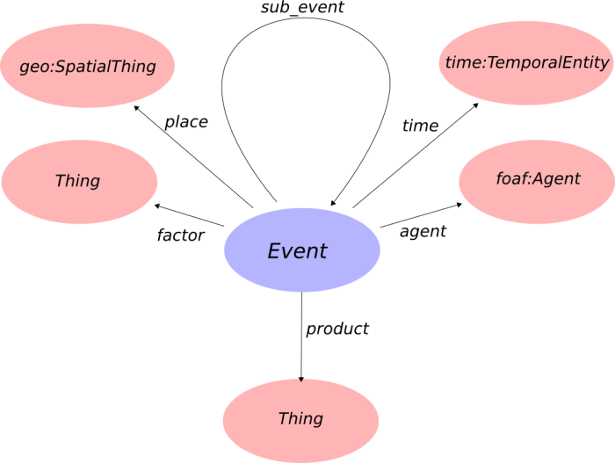

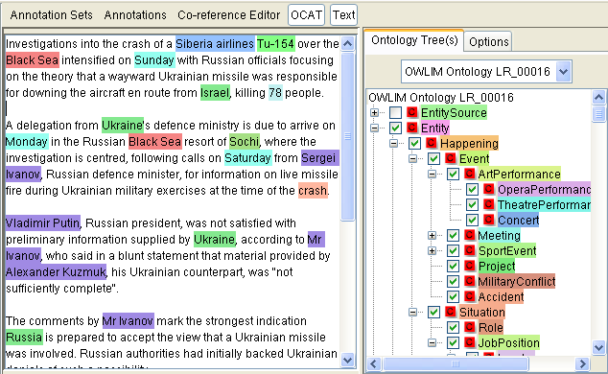
Information Extraction from Notifications
Transform to Security Incident Ontology (SIO) Schema and Save to Triplestore
Updating Data Mart

Slide 5

Machine Readable Security Incident No tification
SIO: Security Incident Ontol ogy
Security Incident Analysis

Slide 6
HOSSEIN FANI

